Slide 1

World Class App
Arnór, Breki, Brynjar, Viktor

Slide 2
Project scope
Make timetables more easily accessible
Booking Classes
Find the closest gym to your location
Workout tracking system
Tracking the amount of people in the gym
Tutorials for exercises
Book a personal trainer or purchase a program
World Class ticket/suggestion system Public chatroom

Slide 3

Stakeholders
Clients from other gyms
Former clients
Current clients
Personal trainer

Slide 4
Interview and survey results
We did an unconventional survey - not focused on an app but on peoples gym experience
Sportabler is the current World Class App
Not used a lot
Our primary challenge is getting our foot in the door
And giving users a worthwhile companion on their wellness journey

Slide 5
The plan
Analyse competitors
Target group research
Risk analysis
Initial release
Focus on next version

Slide 6
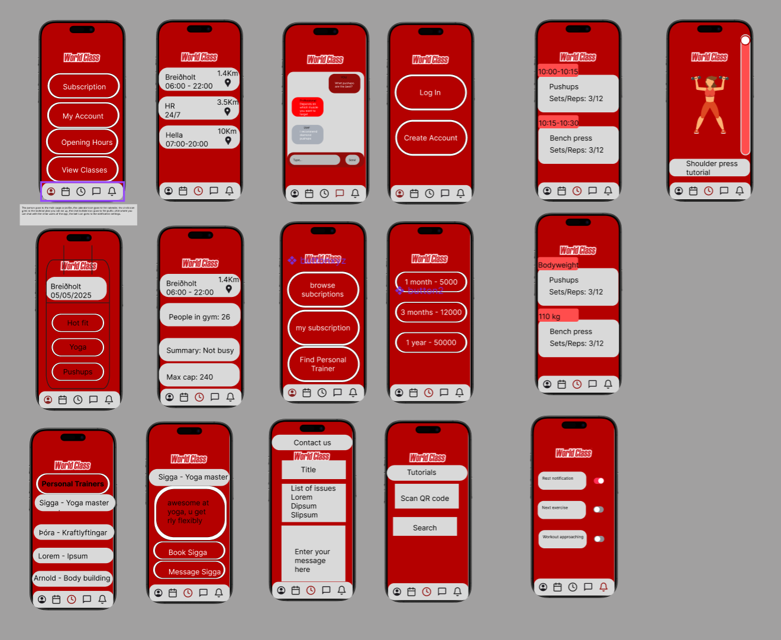
Ui Design process
Single iteration
Create initial design
Get feedback
Update design
Get feedback on updated design
“Make it clearer what each button does.”

Slide 7
Versions
Version 1
Minimum viable product
Only focus on the most essential features
Version 2
Quality of life features
Utility
Version 3
No dramatic changes
Only minor improvements

Slide 8
Risks and mitigation
Type of Risk | Risks | Mitigation
Usability | Many features, flow inside app could become convoluted | Frequent user testing - Polished navigation system
Feasibility | Capacity feature is likely to give wrong numbers | Reset count on gym open, more sensor in gym to see how many people leave vs come in
Usability | Opening hours changing | Notifying the users before the change
Usability | Issues with registration | Placeholders that give examples
Usability, Business | Security in transactions | Two factor authentication
Business viability | Too many messages to WCI | Filtering through similar issues or limiting tickets to a few per week for each user
Usability | Not changeable workout plan | Allow editing of workout plan once it is started
Usability, Value | Tutorial videos not working | Simple pictures as examples with descriptions
Feasibility, Business viability | Amount of features could result in a delay in release | Not have a specific release date, aim for flexibility in feature completion
Usability | Icons without text may lead to poor navigation experience | Add text labels or tooltips to icons
Usability | Red text for “110 kg” may seem like an error or warning | Change red to a neutral color.
Value | Unclear features (like QR SCAN) | Add tooltips
Usability Business | Unclear pricing can lead to user drop-off | Display pricing with clear currency
Usability | Informal trainer descriptions reduce clarity | Change “Professional” to “personal trainer” and include qualifications on click
Usability | Subscription benefits are not explained | Add comparison showing benefits of each plan (e.g. save % per tier )
Usability, Value | Limited readability in chat interface | Increase font size and vertical spacing
Risk assessment
After slicing out an initial development strategy, the next step was to identify potential risks. After identifying the risks, we marked the problem step with red lines in Miro.

Slide 9

Example risk
Type of risk: Usability
Risk: Opening Hours changing
Mitigation: Notify the users before the change.

Slide 10
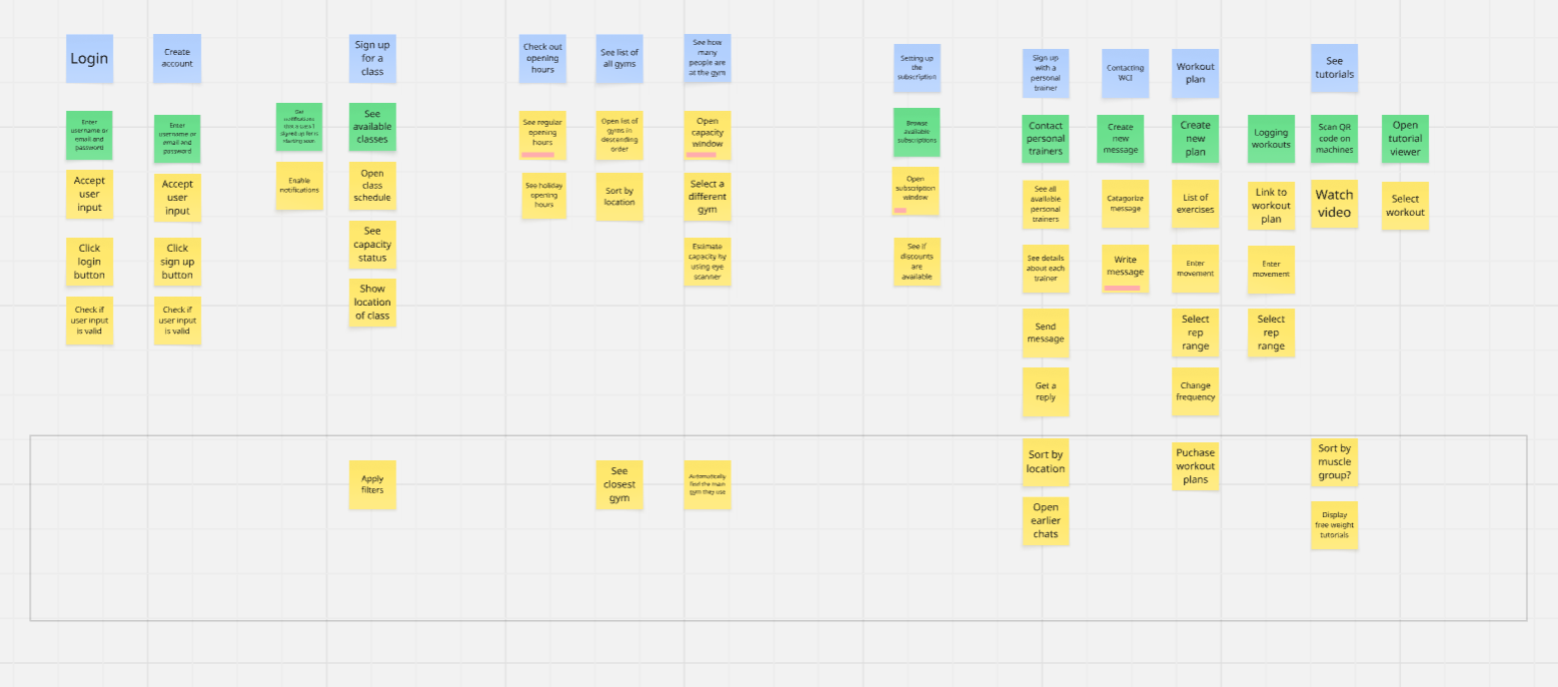
Story mapping
We used miro with notes showing the function along with steps.
Red lines show the risks.
We also used personas as a test to see how these steps would work in the real world.
We used the classic Who, What and Why method to find functionality.

Slide 11
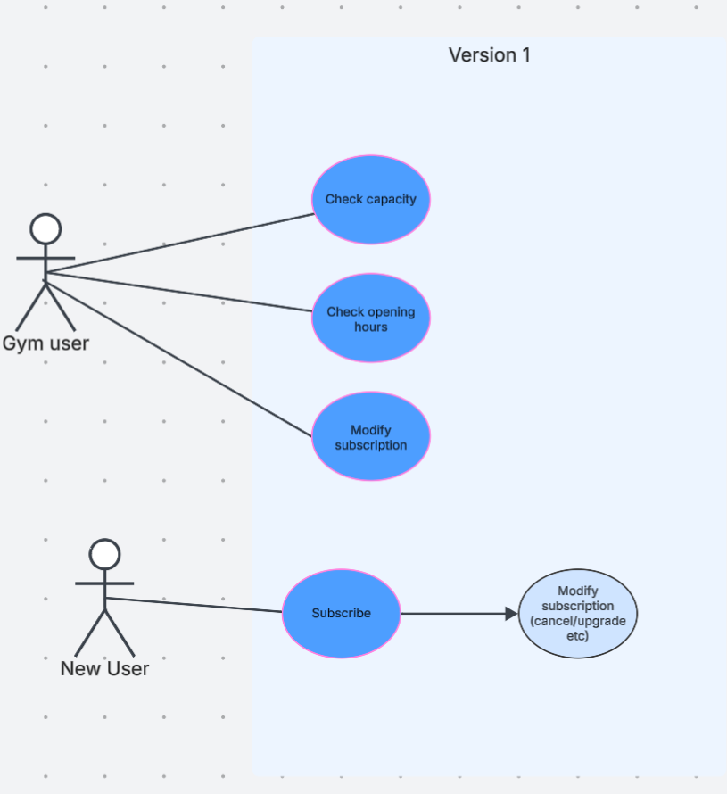
Use case diagrams
We created three versions.
Version 1 focussed on basic features.
Version 2 focussed on setting up classes.
Versions 3 focussed on trainers and extra content.

Slide 12
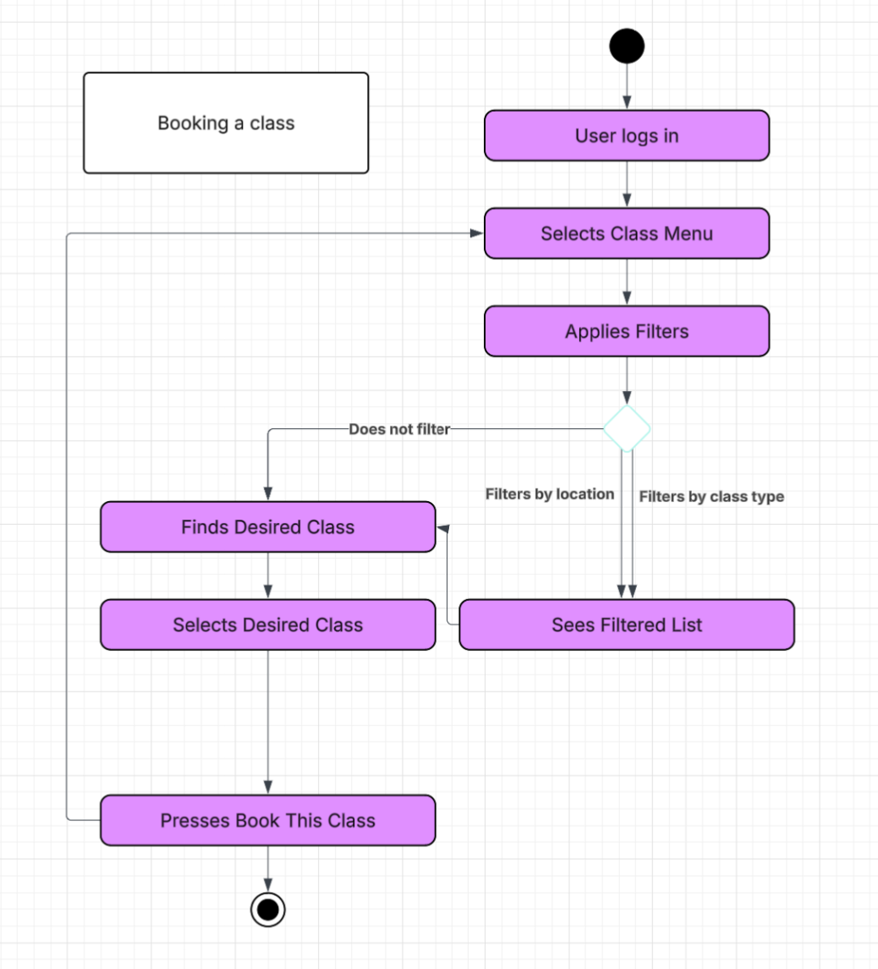
Activity diagram
We made three activity diagrams
Each diagram centers on a version.
The activities are from the Story mapping.
We picked a single activity for each version.

Slide 13

Any questions?

